Slide 1
Python programming
unit 3B – program practice

Slide 2
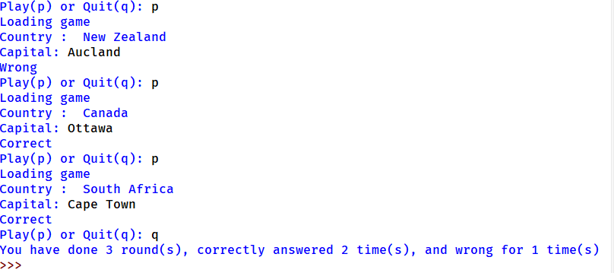
Country-capital game
Computer has a list of many countries and their capital cities.
The game challenge to the player is can remember what is the capital city of specified county. Computer will give the country name and ask player to answer.
After many rounds, when player quit play, computer gives the result of how many correct, how many wrong.

Slide 3
What is in the backpack
Create 2 players for the game. Each player has 4 items in his/her backpack
Each player plays in turn. When one player plays, guest what is in the other player’s backpack. If guess correct, that item was removed from other player’s backpack.
Until one player’s backpack is empty, he/she lose the game.

Slide 4
Flow chart for the game
START
2 player user name and backpack items
One round play: user 1 guess
Y
Correct guess?
Update score, remove user 2 backpack
N
One round play: user 2 guess
Y
Update score, remove user 1 backpack
Correct guess?
N
Any user backpack all finish?
Y
N
Next round?
Y
N
Show score and results
END

Slide 5
Word counting program
Read one article (one file) from stdin or as file.
Analyse the words in the article: count how many times appeared for each word

Slide 6
Reverse of list
Make a function, call it reverseList(). Take an argument of list type, and return a new list with all item in reversed order. --- (don’t call the list.reverse() method. Build your own version)
Make a function, call it reverseListInPlace(). Take an argument of list type, change the list items order in reverse and then return. (no need return value) --- (don’t call the list.reverse() method. Build your own version)

Slide 7
Judge number is even or odd – use recursion
Number is 1, it is odd
Number is 0, it is even
For any number n, it is same even or odd as n-2
Use the above rule to define a function, which can recursive call and give a judgement one number is even or odd.
Test your function.

Slide 8
Number puzzle
Number sequence.
The first number is 1.
The next number is calculated based on the previous number. You can either choose to multiply by 3, or choose to add by 5.
Now give a number, can you make a program to judge if this number is inside one of the above sequence? If it is can you find a sequence which can product this number?

Slide 9
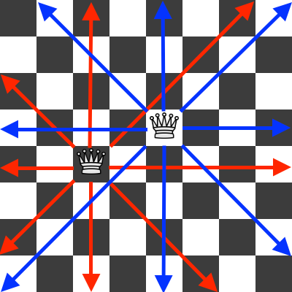
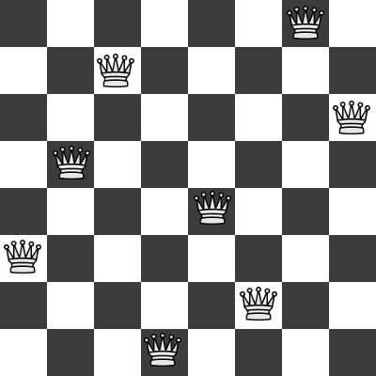
8 Queen puzzle

Slide 10
Queue simulation program
Create a program of simulation.
Every minute comes a random number person of (0~5), to queue and buy coffee.
Every guest takes around 15 ~ 20 seconds to finish service.
Observe how the queue depth changes with time.
Record and study each person’s waiting time.

Slide 11
stack simulation program
Create a program of simulation.
Every day comes a random number of files waiting to be signed (0~10), which was put on a table.
Every day take 6 files from table, process and sign it.
Observe how the stack depth changes with time.
What if you feel not work and work efficiency reduce to only process 4 files one day?
Record and study each file waiting time.

